Slide 1
Emerging Experiences / More Personal Computing (MPC)
Tim Huckaby, Chairman/Founder, TimHuck@InterKnowlogy.com, @TimHuckaby
Dan Hanan, Sr Director of Engineering, DanH@InterKnowlogy.com, @VolleyNerd
Szymon Kobalczyk, IK Engineer, Szymonk@InterKnowlogy.com, @skobalczyk
Piotr Karczmarz, IK Engineer, Piotrk@InterKnowlogy.com, @piotrkarczmarz
Notes:
99 talking slides
99 demos and videos
© 2015 InterKnowlogy, LLC. All rights reserved.

Slide 2
A Little Bit About Us and Why We are Here
Tim Huckaby
InterKnowlogy Chairman/Founder
Actus Interactive Software & VSBLTY Chairman/Founder
Microsoft RD & MVP
TimHuck@InterKnowlogy.com
Dan Hanan
Sr Director of Engineering
11 Years at IK
C++, COM, WCF, SQL, … C#, XAML, Web, …
DanH@InterKnowlogy.com
Szymon Kobalczyk
IK Engineer
8 Years at IK
C#, XAML, 2D, 3D, Kinect, Math ☺, …
SzymonK@InterKnowlogy.com
Piotr Karczmarz
IK Engineer
2 Years at IK
C#, SQL, XAML, Kinect, …
PiotrK@InterKnowlogy.com
Notes:
© 2015 InterKnowlogy, LLC. All rights reserved.

Slide 3






InterKnowlogy (IK) is an end-to-end service delivery shop focused on bringing tech to the enterprise that is intuitive and easy to use. IK services include ideation to transform business challenges and vague concepts into amazing solutions, interaction design to create beautiful user experiences, to complex app development and deployment with support services. We build our natural user interface (NUI) solutions on XAML, WPF, WinRT, HTML5 and/or Windows Phone.
Natural User Interface (NUI). IK has been focused in NUI for the past 7 years. We ideate, design, build, and deploy NUI apps on all shapes of hardware, including phone, tablet, wall, and/or table. IK knows how to build apps where touch and gesture are the primary ways users interact with the experience.
User Interaction Design. IK’s expertise in User Interaction design, (IxD), as implemented in the Natural User Interface (NUI), is heavily focused on satisfying the needs and desires of the majority of people who will use our software products. Our main focus is on natural behaviors (touch, gesture and voice recognition) when using the software we build. Other disciplines, like software engineering, have a heavy focus on designing for technical stakeholders of a project. We believe in designing software for the actual users.
App Renovation. IK transforms existing apps with NUI technology. We can re-factor any app into a NUI experience. But our app renovation isn’t skin deep – we go beyond transforming your app for touch and bringing the well-travelled app pathways to the forefront. IK rebuilds the app with a solid app architecture foundation so that new features can be easily added, and the app can be more thoroughly tested in less time.
Big DATA + Rich Data Visualization. IK visualizes data in context to the user, breaking the barriers of standard maps and charts for information viewing. By intelligently displaying data, rather than using broad and generic strokes, we enable users to glean insights not before possible.
Enterprise Mobile Apps (EMA). IK has two focus areas in EMA – expanding your brand and service through massive consumer consumption, and increasing the productivity of your employees through mobile enablement of your enterprise software.
Notes:
InterKnowlogy is a great company; it’s a great company to work for
This is a busy slide called a battlecard which is supposed to represent what we do, but the next slide is a lot more relevant to what we do
I do these presentatoions and keynotes out of a labor of love. I’m not paid to do this. I love talking to excited technologists. I love software and I have been doing it a long time.
And you never know, every once in a while we get an new employee or a new customer when I do a keynote.

Slide 4






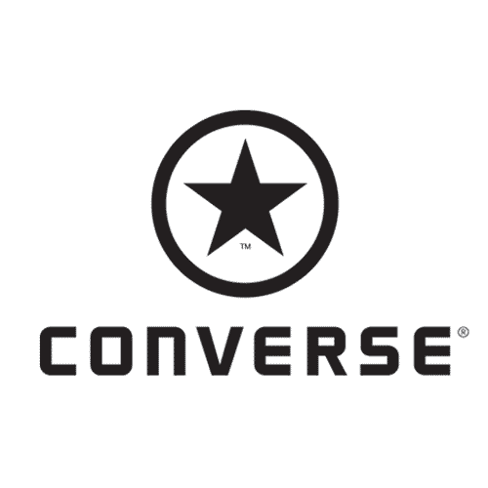


























Who we work for
Notes:
© 2015 InterKnowlogy, LLC. All rights reserved.

Slide 5
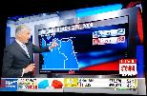
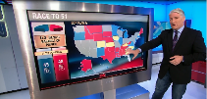
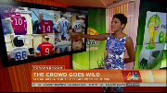
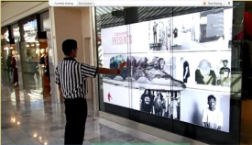
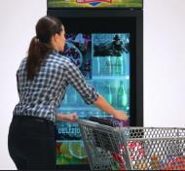

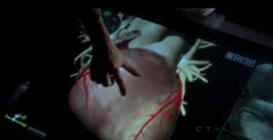

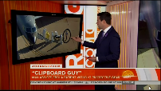
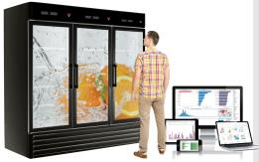
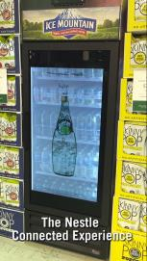
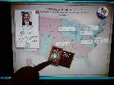
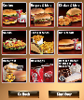
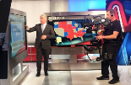
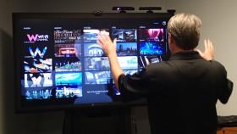
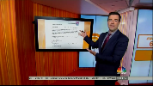
Notes:
© 2015 InterKnowlogy, LLC. All rights reserved.

Slide 6
Objectives And Agenda
User Interaction Design (IxD) – A New Frontier of Design…
Guidance in NUI: Innovation in Touch, Gesture & Voice Driven User Experiences
NUI Technology Roadmap, Speculations & Predictions
The Tenets of Engaging User Experiences & Attraction
Where We have Been and Where We are Going
Demos, Demos, Demos….

Slide 7
The Natural User Interface
Multi-Touch Capable
Common Gestures of Touch
Physical Object Interaction
Virtual Object Interaction
Gesture Capable
Motion Based Interface
Tracking of full-body movement, facial expression, and voice with precision
Voice Capable
Multi-array Microphone
Uniquely Distinguish Audio & Voices
Neural Capable
Conscious and non-conscience interfaces
Non Invasive
Manifested In:
Large Form Factors, Haptic Interfaces, Virtual Reality (VR), Augmented Reality (AR)
Notes:
This is my definition of NUI
Others include haptic interfaces and augmented reality in their definition of NUI.
This is where we are and where we are going
And this is my prediction of where software is headed in terms of User Experience, User Engagement, and User Interface
© 2015 InterKnowlogy, LLC. All rights reserved.

Slide 8
November, 2007
Notes:
Does anyone recognize this date? I don’t expect you to. But, this is the date that essentially exploded the NUI revolution.
And as painful as this is for me to tell you… having worked for or with microsoft for over 20 years….
I have been preaching NUI for over 6 years… because Microsoft provided a beautiful API for touch in 2007.
But, it wasn’t until this date that using touch in a computer system became a main stream, prevalent way to use a computer system.
© 2014 InterKnowlogy, LLC. All rights reserved.

Slide 9

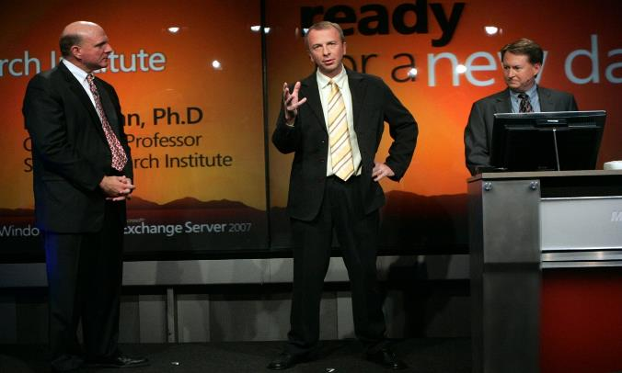
The First Time Touch was available on a Major Platform
Notes:
Well, it’s the date of the launch of windows vista – the first touch capable Microsoft OS
Notice how I say “touch capable”. Just because it’s touch capable doesn’t mean it’s designed for touch and consequently it was really hard to use that OS with touch.
But, in WPF we got our first API for touch. And it was beautiful and elegant.
© 2014 InterKnowlogy, LLC. All rights reserved.

Slide 10
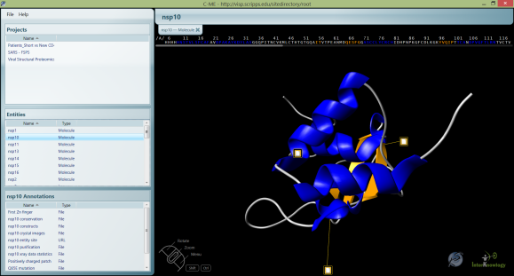
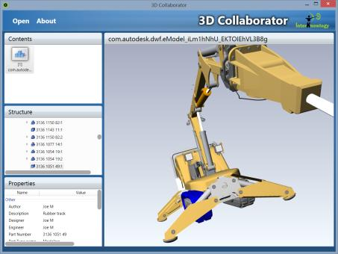
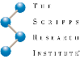
C-ME / 3D Collaborator
Tim Huckaby
Chairman / Founder,
InterKnowlogy, Actus Interactive Software, VSBLTY

Slide 11
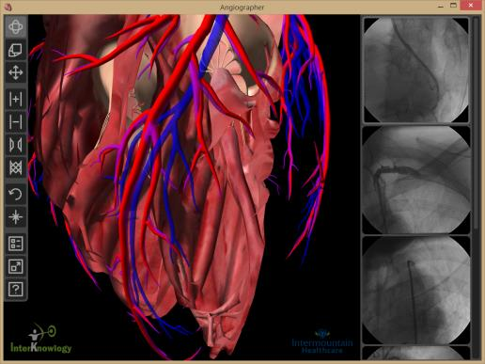
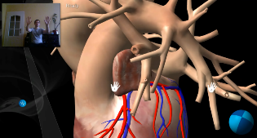
Angiographer / Gesture Heart
Tim Huckaby
Chairman / Founder,
InterKnowlogy, Actus Interactive Software, VSBLTY

Slide 12
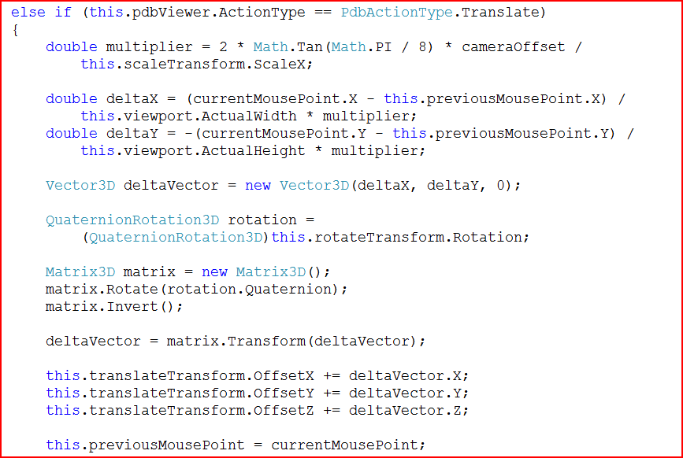
3D in WPF
Check out the method level support for Rotation
This is why I should have paid attention in high school calculus..

Slide 13
January 27, 2010
Notes:
Does anyone recognize this date? I don’t expect you to. But, this is the date that essentially exploded the NUI revolution.
And as painful as this is for me to tell you… having worked for or with microsoft for over 20 years….
I have been preaching NUI for over 6 years… because Microsoft provided a beautiful API for touch in 2007.
But, it wasn’t until this date that using touch in a computer system became a main stream, prevalent way to use a computer system.
© 2013 InterKnowlogy, LLC. All rights reserved.

Slide 14
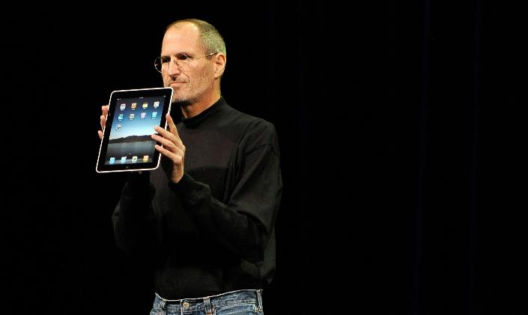
Notes:
Well, it’s the date Steve Jobs introduced the Ipad
So what does the $800 toy have to do with NUI?
Well, these geniuses of design in the silcon valley built a computer system designed for touch.
Who would have thought a browser could be developed where touch is the primary method of input?
And they did an awesome job.
Let’s face it. Windows vista and windows 7 were both touch enabled, but not designed for touch. Just touching the start button with your finger is a challenge because of it’s location on the screen and it’s size. Touching t he little red x to close a window with your finger? Forget it.
Now windows 8 is designed for touch with it’s big tiles and metro interface. But, these guys paved the way for NUI almost 3 years ago.
© 2013 InterKnowlogy, LLC. All rights reserved.

Slide 15
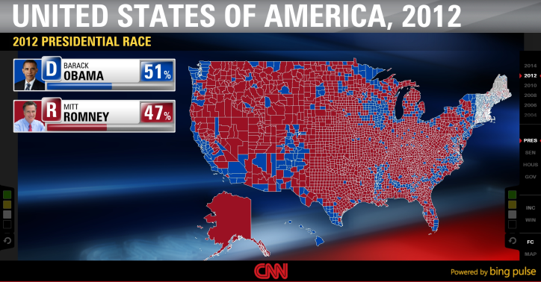
CNN Magic Wall
Dan Hanan
Sr. Director of Engineering,
InterKnowlogy
CNN Magic Wall – Project Tech Lead
Piotr Karczmarz
InterKnowlogy Engineer
Automated UI Testing of Rendered Data

Slide 16
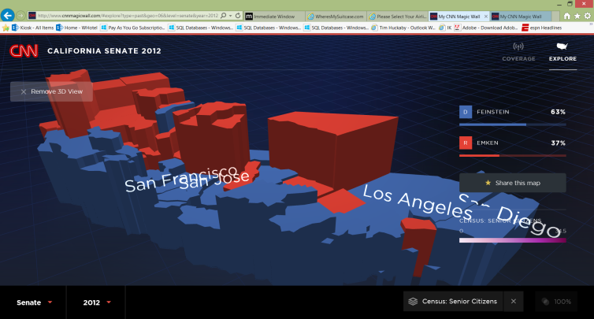
CNN Magic Wall – HTML5
http://www.cnnmagicwall.com
Dan Hanan
Sr. Director of Engineering, InterKnowlogy

Slide 17
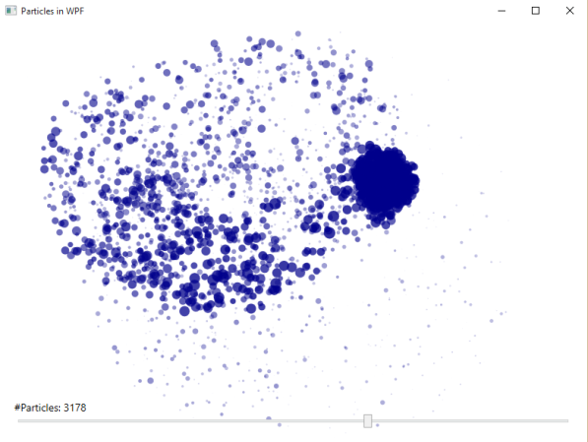
2D Rendering Performance
Szymon Kobalczyk
InterKnowlogy Engineer
UI Performance: XAML, Win2D, DirectX
Source available on GitHub
https://github.com/kobush/Win2D-Demo/

Slide 18
IK – How Do We Run Projects?
Consulting Services – Projects with Agreed Upon Features
Estimate, Schedule
Projects anywhere from 2 months to multiple years
Project Manager, Tech Lead, Engineers, Customer
UI Design via IK Designers
Notes:
DH – know this looks like boring content, I promise to not be too dry. Since we’re ultimately trying to find a couple engineers out here, I want them to get a taste of what a project is like.
© 2013 InterKnowlogy, LLC. All rights reserved.

Slide 19
IK – How Do We Run Projects? (2)
Agile: Sprints, Daily Stand-Ups, Trading Features, Backlog, Capacity, Testing
TFS / VSO – Work Items
TFS, GIT – Source Control
Working Remotely
Engineering Resources Flow Project to Project
Notes:
DH – know this looks like boring content, I promise to not be too dry. Since we’re ultimately trying to find a couple engineers out here, I want them to get a taste of what a project is like.
© 2013 InterKnowlogy, LLC. All rights reserved.

Slide 20
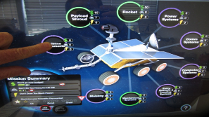
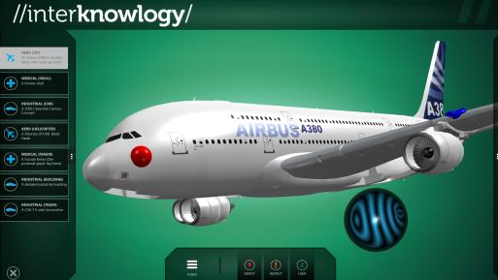
Good User Interaction Design: Software Designed for Touch; Not just Touch Capable
Large, Natural Looking & Behaving Controls
Intuitive
Smoothing; Fidelity Correction
Ubiquitous Touch Gestures like “pinch”
Notes:
New form factors large and small mandate intelligent design that borders on industrial engineering.
Natural behavior of virtual objects frequently make for great user experiences and powerful user interfaces.
Frequently software real-time is too fast for the human eye when used in large form factor screens.
© 2013 InterKnowlogy, LLC. All rights reserved.

Slide 21
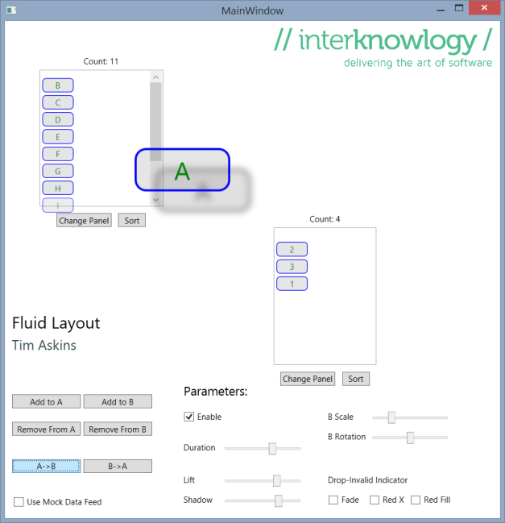
Fluid Layout / Natural Data Bench
Tim Huckaby
Chairman / Founder,
InterKnowlogy, Actus Interactive Software, VSBLTY

Slide 22
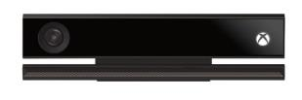
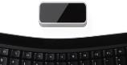
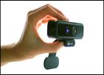
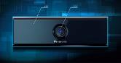
3D Cameras
Kinect for Windows
$200
http://www.microsoft.com/en-us/kinectforwindows/Multi-Platform
.NET
Leap Motion
$70
https://leapmotion.com
Multi-Platform
SoftKinetic (Intel Real Sense)
http://www.softkinetic.com
$249
Distance and Near Mode; Multiple Products
In the space for over a decade
Panasonic
Works outside in direct sunlight
$2,600
Notes:
Kinect has competition too and that is a good thing. As far as I am concerned Leap is still smoke and mirrors because they have not shipped yet, but if they live up to the performance of the marketing videos they made this will be a compelling solution for navigating interfaces up close on all platforms with two fingers
Now SoftKinetic is a great company and has been around forever. Their devices do up close and far away with fidelity and look at the form factor of the device. It’s tiny. And unlike the Kinect it’s usb only. No requirement for power.
Let me show you….
© 2013 InterKnowlogy, LLC. All rights reserved.

Slide 23
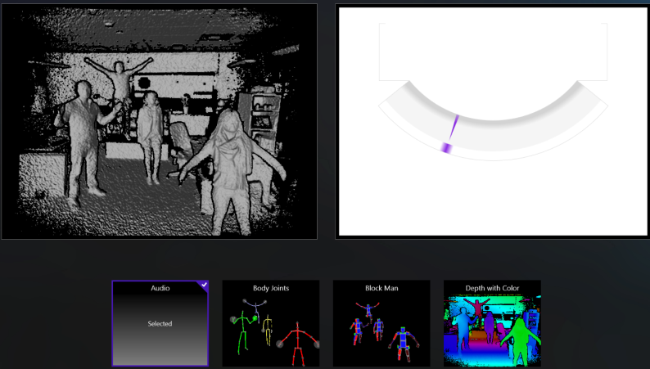
Kinect Evolution
Tim Huckaby
Chairman / Founder,
InterKnowlogy, Actus Interactive Software, VSBLTY

Slide 24
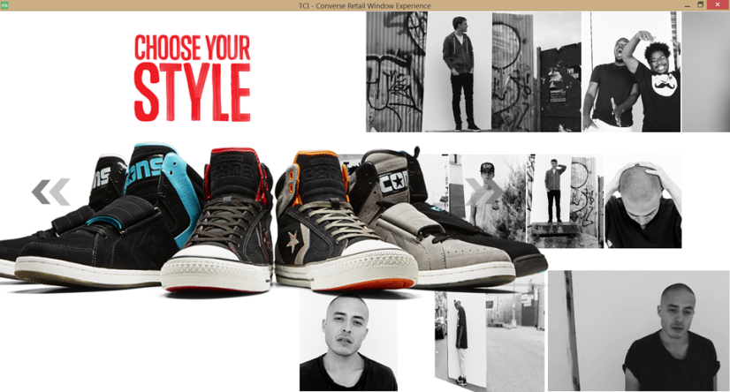

Converse/Nike World-Wide Shoe Launch
Tim Huckaby
Chairman / Founder,
InterKnowlogy, Actus Interactive Software, VSBLTY

Slide 25
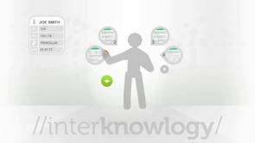
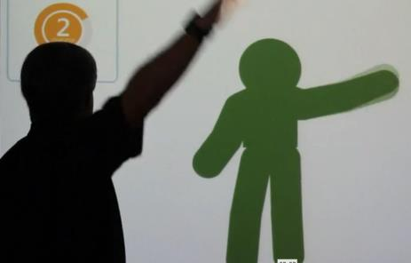
Touch-less Operating Room
Tim Huckaby
Chairman / Founder,
InterKnowlogy, Actus Interactive Software, VSBLTY

Slide 26
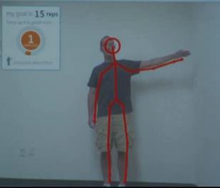
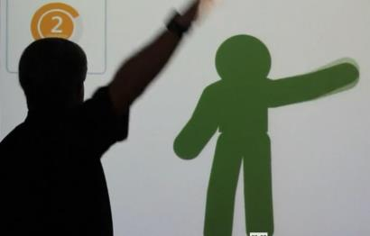
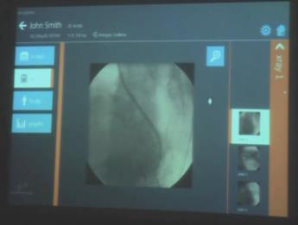
IK Physical Therapy
Tim Huckaby
Chairman / Founder,
InterKnowlogy, Actus Interactive Software, VSBLTY

Slide 27
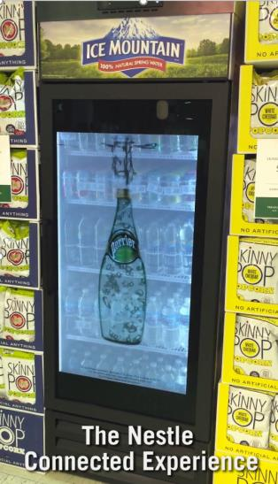
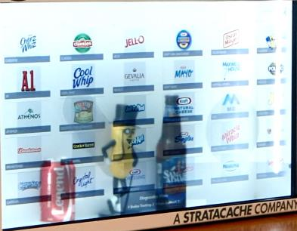
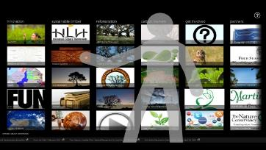
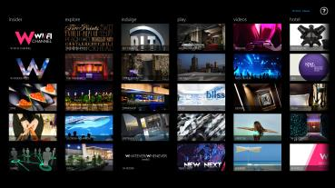
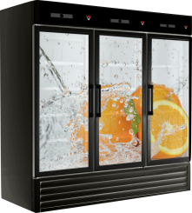


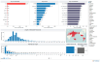

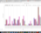

VSBLTY VisionCaptor
Tim Huckaby
Chairman / Founder,
InterKnowlogy, Actus Interactive Software, VSBLTY

Slide 28
The Kinect is Watching you....

Slide 29
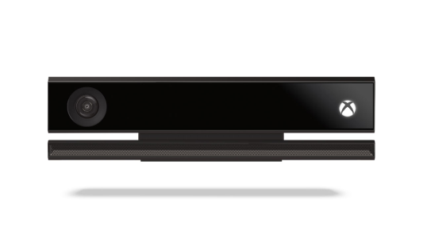
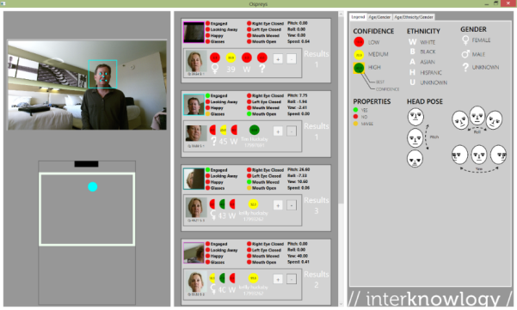
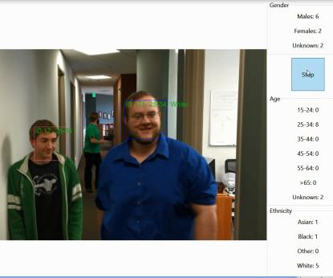
Demographic Profiling & Facial Recognition
Tim Huckaby
Chairman / Founder, InterKnowlogy & Actus Software
Piotr Karczmarz
InterKnowlogy Engineer

Slide 30
3D Cameras: Empowering the Consumer at the expense of Pushing the Laws of Privacy
Demographic Driven Content – Age, Race, Gender
Facial Recognition / Identification with performance, accuracy and scale
Authentication Assistance
Security Augmentation
…in a Cost Effective Manner….

Slide 31

Remember This?

Slide 32

Microsoft HoloLens

Slide 33



‘We are within a Decade of Building the “Holodeck”’ -Tim Huckaby ~ 2009 The Ultimate NUI Application
Notes:
My prediction is that we are within a decade of true technology that manifests enviroments which span the chasm between physical and virtual. The ultimate natural user interface applications.
© 2013 InterKnowlogy, LLC. All rights reserved.

Slide 34

Video
Microsoft HoloLens

Slide 35
Summary
The concepts of engagement and Good User Interaction Design change the way we design and build software in many Use Cases.
…when the goal is better user experiences
The hardware, tools, plumbing and platform for good user Interaction Design in Applications are powerful and available now.
…and will just continue to get better, cheaper, powerful and more available
NUI provides a number of challenges to good User Interaction Design:
Large and Intuitive Controls
Large Form Factors
Naturalizing Interactions with Virtual and Physical Objects
Fidelity and environment weaknesses of 3D Cameras
Within a realistic time frame NUI computing will be the norm
…just like the mouse & keyboard are

Slide 36
Contact Us
Tim Huckaby, Chairman/Founder, TimHuck@InterKnowlogy.com, @TimHuckaby
Dan Hanan, Sr Director of Engineering, DanH@InterKnowlogy.com, @VolleyNerd
Szymon Kobalczyk, IK Engineer, Szymonk@InterKnowlogy.com, @skobalczyk
Piotr Karczmarz, IK Engineer, Piotrk@InterKnowlogy.com, @piotrkarczmarz
Notes:
99 talking slides
99 demos and videos
© 2015 InterKnowlogy, LLC. All rights reserved.

Slide 37


Tim Huckaby
More info on InterKnowlogy:
www.InterKnowlogy.com
www.vimeo.com/InterKnowlogy
More info on Actus Software:
www.Actus-Software.com
About Tim Huckaby…
Founder/Chairman, InterKnowlogy & Actus Software
Microsoft® Global Regional Director
Microsoft® AppDev Partner Advisory Council Founder / Member
Microsoft® MVP – Kinect for Windows
Accomplished Author & Speaker
Board Member: Facial Networks
Board Member: San Diego Fly Fishers
www.TimHuckaby.com
Contact Tim: E-mail: TimHuck@InterKnowlogy.com
TimH@Actus-Software.com
Phone:
Office: 760-444-8640
Mobile:: 619 990 9200
Blog:
http://team.interknowlogy.com/blogs/timhuckaby
FaceBook:
http://www.facebook.com/Tim.Huckaby.Carlsbad
LinkedIn:
http://www.linkedin.com/in/timhuckaby
Twitter: @TimHuckaby
Notes:
Here’s how you can get a hold of me; track me and the companies.
© 2013 InterKnowlogy, LLC. All rights reserved.

Slide 38



Tim Huckaby
InterKnowlogy Chairman/Founder
Actus Interactive Software Chairman/Founder
Microsoft RD & MVP
E-mail: TimHuck@InterKnowlogy.com
TimH@Actus-Software.com
Phone: Mobile:: +1 619 990 9200
Blog:
http://team.interknowlogy.com/blogs/timhuckaby
FaceBook:
http://www.facebook.com/Tim.Huckaby.Carlsbad
LinkedIn:
http://www.linkedin.com/in/timhuckaby
Twitter: @TimHuckaby
Notes:
One hour session
DAN – HUCK: replace this with something like the next slide.

Slide 39





A little bit about me and why I am here…
Delivering the Art of Software
Notes:
I have grey hair and I’ve been doing this a long time and I genuinely enjoy speaking to technical audiences like you…
You don’t know me or my company. I have spent a 25+ year career next to the “big guy” on stage. You see him; you don’t see me.
I worked on some server product teams in the late nineties. I worked with some famous products and one really bad one.
I have been working for or with Microsoft for over 25 years….
DH – HUCK: nuke this, and we each do a short intro of who we are on the previous slide. Maybe you go last of the 4 of us, cuz then you roll right into your first demo.
© 2013 InterKnowlogy, LLC. All rights reserved.

Slide 40

Actus Interactive Software
www.Actus-Software.com
Interactive Kiosk & Active Digital Signage Software
The Content Defines the Experience
Agnostic to Industry and Vertical Market
Attract Mode Engages Powerful CMS / Dynamic Synchronization of Content
The Natural User Interface (NUI): Touch, Gesture & Voice Controlled
Large Tiles / Shallow Navigation / Flexible Content
Contact: JayH@Actus-Software.com
www.Actus-Software.com
Notes:
My real day job is supposed to be this startup, Actus Interactive Software.
It’s a software

Slide 41


Telestr8– Designed for Touch
Demo
Tim Huckaby
Founder / Chairman, InterKnowlogy
Founder / CEO, Actus Software
Microsoft RD & MVP
Notes:
Demos:
In general show avatar navigation and the 7-11 foot sweet spot of Kinect. Talk to skeletal tracking and trackin in depth and macro modes
Actus Interactive Digital Content solution: demo the W hotel Atlanta content set. Reenforce the design principals of engagement: can I eat it? Can it eat me? Can I mate with it? Also show avatar navigation and how effective it can be as an attractor
InterKnowlogy Physical Therapy app. Kinect driven app to do your PT. Use case: home health care.
InterKnowlogy Touch-less OR. Great use case for Kinect: touchless operating room where sterile environments are paramount and access to information quickly is perfect with gesture and voice.
© 2013 InterKnowlogy, LLC. All rights reserved.

Slide 42

Telestr8– Designed for Touch
Demo
PPI “Media-tor”
Tim Huckaby
Founder / Chairman, InterKnowlogy
Founder / CEO, Actus Software
Microsoft RD & MVP
Notes:
Demos:
In general show avatar navigation and the 7-11 foot sweet spot of Kinect. Talk to skeletal tracking and trackin in depth and macro modes
Actus Interactive Digital Content solution: demo the W hotel Atlanta content set. Reenforce the design principals of engagement: can I eat it? Can it eat me? Can I mate with it? Also show avatar navigation and how effective it can be as an attractor
InterKnowlogy Physical Therapy app. Kinect driven app to do your PT. Use case: home health care.
InterKnowlogy Touch-less OR. Great use case for Kinect: touchless operating room where sterile environments are paramount and access to information quickly is perfect with gesture and voice.
© 2013 InterKnowlogy, LLC. All rights reserved.

Slide 43
Barriers to Good Interaction Design in Touch on the Windows Platform
As Microsoft Matured their App-Dev Touch platform, the Windows Team, Hardware OEMs and Software ISVs ignored it
…While Apple & it’s App Builders Embraced it and Designed for it.
In WPF (.NET), touch is a first class citizen
But, it’s ignored by the software control vendors
Example: Originally, Google chrome was not built to the Windows touch specification
Ignored touch events

Slide 44
The 7 Tenets of an Engaging UX
1. Use the Power of Faces
2. Use Food, Sex and Danger
3. Tell a story
4. Build commitment over time
5. Make it Intuitive & Easy to Use
6. “Game-ification”
7. Use Natural Interactions & Behaviors
Notes:
So here is what we are going to talk about today….
6- Make it intuitive and easy (jack in the box)
7- Make it a game (jumpido, nasa)
© 2013 InterKnowlogy, LLC. All rights reserved.

Slide 45



The 7 Tenets of an Engaging UX
1. Use the Power of Faces
People love faces; We see faces where they don’t exist
We have DNA with the sole purpose of recognizing faces
Take advantage of this by putting faces on your App
Have the faces to look at important part of your App
People instinctively follow the eyes of the face.
2. Use Food, Sex and Danger
When someone sees something new, they place it into one of four categories:
Can I Eat it?
Can it Eat Me?
Can I Mate with it?
…and everything else.
If you want your App to be engaged and interesting, put it in one of the first three categories.
Notes:
The tenants of a great, engaging user experience:
The power of Faces
Use Food, Sex, and Danger
In user interfaces where engagement is the primary goal, the most effect attractor is "can I eat it? Can it eat me? Can I mate with it?" humans are wired that way. but, importantly, it works best when the goal is attracting users to your app/interface (kiosks, web sites, etc.). for systems used in your job, or in a car, engagement is assumed and usability is a much more important attribute.
© 2013 InterKnowlogy, LLC. All rights reserved.

Slide 46



The 7 Tenets of an Engaging UX
3. Tell a story
We learn through stories. It’s how we teach our children. It’s the Bible; It’s what we see in movies.
Stories are a big part of how information is conveyed to us.
If you have information to give to the user, put it in story form.
It doesn’t matter what medium you use (words, pictures, music), but using a story narrative will help your user understand and retain your information.
4. Build commitment over time
Let the user choose how they want to interact with you (RSS, Twitter, Facebook)
Make sure that you don’t take advantage of the trust that is implicit in that interaction.
5. Use Natural Interactions of Objects
Natural Movements
Fluidity
Animate / Exaggerate: Slow things down so the eye can follow
Notes:
The tenants of a great, engaging user experience:
Tell a Story
Build Commitment over time
Use Natural Interactions of Objects
© 2013 InterKnowlogy, LLC. All rights reserved.

Slide 47


The 7 Tenets of an Engaging UX
6. “Game-ification”
We Live in a Gaming Culture
The Digital Natives Expect a Contest
Even When Learning
It doesn’t fit all use cases, but if you can provide “game-fication” you’ll get engagement
7. Make it Intuitive and Easy to Use
Todays Generations, especially the Digital Natives, Don’t Read User Manuals.
Accessibility is expected in the Elderly Culture
The “Grandma Huckaby Theory”
If Grandma Huckaby walks up to a piece of software we have built and is immediately effective we have succeeded.
Notes:
The tenants of a great, engaging user experience:
The power of Faces
Use Food, Sex, and Danger
In user interfaces where engagement is the primary goal, the most effect attractor is "can I eat it? Can it eat me? Can I mate with it?" humans are wired that way. but, importantly, it works best when the goal is attracting users to your app/interface (kiosks, web sites, etc.). for systems used in your job, or in a car, engagement is assumed and usability is a much more important attribute.
© 2013 InterKnowlogy, LLC. All rights reserved.

Slide 48




Cincinnati Children's Hospital The Power of Faces
Demo
Tim Huckaby
Chairman / Founder, InterKnowlogy & Actus Software
Notes:
Demos:
In general show avatar navigation and the 7-11 foot sweet spot of Kinect. Talk to skeletal tracking and trackin in depth and macro modes
Actus Interactive Digital Content solution: demo the W hotel Atlanta content set. Reenforce the design principals of engagement: can I eat it? Can it eat me? Can I mate with it? Also show avatar navigation and how effective it can be as an attractor
InterKnowlogy Physical Therapy app. Kinect driven app to do your PT. Use case: home health care.
InterKnowlogy Touch-less OR. Great use case for Kinect: touchless operating room where sterile environments are paramount and access to information quickly is perfect with gesture and voice.
© 2013 InterKnowlogy, LLC. All rights reserved.

Slide 49
The 6 Tenets of Attraction
1. Movement
2. Use Avatars
3. UI affected by Body Movement
4. Sound
5. 3D
6. Collaboration
Notes:
So here is what we are going to talk about today….
6- Make it intuitive and easy (jack in the box)
7- Make it a game (jumpido, nasa)
© 2013 InterKnowlogy, LLC. All rights reserved.

Slide 50


InterKnowlogy POC-Tetra: Interactive Digital Signage & Attraction Algorithm
Demo
Tim Huckaby
Chairman / Founder, InterKnowlogy & Actus Software
Notes:
© 2014 InterKnowlogy, LLC. All rights reserved.

Slide 51


Our “Game-ification” Culture NUI Experiences that Enhance Learning
Learning made Fun / Entertaining
Proven as a learning tool beyond just Children
Computer based Games are a significant part of popular culture
University Level Educational Video Game Curriculums
MIT, UC Irvine, Minnesota, Michigan State, etc.
Notes:
We are in a culture of “game-ification”. Things like xbox have paved the way for that. Exercise and physical therapy are obvious use cases. But learning is the ultimate use case.
Science and the culture have proven that when presented with a game like challenge, software is much more effective in learning.
Even universities now have specializations in electronic learning.
© 2013 InterKnowlogy, LLC. All rights reserved.

Slide 52

We have come a Long Way in User Interface…
The “Green Screen”
52
Notes:
This is similar to the type of computer I first started programming. I have grey hair. I have been doing this a long time.
This computing device was expensive
Frequently it’s user interface involved a stack of punched cards.
In 1984 I got to use one of the first PCs. It was an IBM XT and it was $10k
© 2013 InterKnowlogy, LLC. All rights reserved.

Slide 53

We have come a Long Way in User Interaction
Image Courtesy of Computer History Museum
Notes:
Does anyone know what this thing is? Well, it’s one of the first mice.
Invented by a guy at Xerox or ibm in florida.
Why do I show you this. Because I was there when the first GUIs came out. I was there when they told us we needed to take our right hand off the keyboard and reach for this mouse thing. Now I’m a machine gun in terms of typing. I went to an all boys catholic school. We didn’t have wood shop; we didn’t have computers. We had latin and typing.
So, taking my right hand off the keyboard was the most unnatural thing in the world. The learning curve to that use of the computer was huge for me and for everyone. But, guess what? Cut to today and we consider the mouse second nature. It’s not awkard at all. In fact, it is natural. And now touching a computer system is natural and a prevalent way to interact with computer systems.
I will argue that gesturing at computers ; speaking at computers and ultimately thinking at computers will become prevalent and commonly accepted ways of using computers in a few short years and over the next decade. And I am going to enforce / try to prove that with this presentation.
© 2013 InterKnowlogy, LLC. All rights reserved.

Slide 54



Touch Capable Computing Devices Are Not New…
1972: PLATO IV
Touch Screen Terminal
Apple iPad
Windows 10 SurfaceHub
Past
Present
Future (now)
Notes:
Touch capable devices have been around a long time…. Since 1972!
We have seen them in the form of kiosks for a long time.
Historically these systems were black boxed vertical systems with very little integration capability
© 2013 InterKnowlogy, LLC. All rights reserved.

Slide 55




What is Relatively New is:
Multi-Touch Hardware
Inexpensive Touch Capable, Non Proprietary Hardware
Operating Systems designed for Multi-Touch
A Consistent Multi-Touch API for the major Hardware/Software Platforms
Developer Productivity in Touch Capable Apps
The Forecast of Multi-Touch Hardware Capability in Every New Computing Device in the Short Term
Gesture, Voice Recognition, Hapticks
Inexpensive 3D Cameras
Natural Movements / Natural Interactions
Fidelity: Reliable and Dependable
Safe: anti-bacterial
Becoming a norm of using computing systems
Notes:
What is new is touch capable devices at a price point for the masses.
And at a price point for windows 7/8 that is realistic for every consumer.
And an apple device going 4 to $800 for the consumer that has such strong brand identity that it doesn’t matter what it costs.
Every computer shipping over the next many years will have touch capabilities. You will get touch capability in your device whether you like it or not. Display screens, notebooks, tablets, smart phones.
Inexpensive touch capable desktops and laptops are available right now.
You won’t have to give up your mouse just yet, but there are many software scenarios where it makes more sense to put your fingers on the screen….
I have already shown a number of compelling use cases for NUI….
But, here is one that still doesn’t make sense: CRUD
What is also new and exciting is a Operating Systems designed for touch….
And a powerful multi-touch api in all the software platforms.
© 2013 InterKnowlogy, LLC. All rights reserved.

Slide 56




EMN8 – Fast Food Kiosk Food, Sex & Danger / Natural User Interface / Make it easy and intuitive
Demo
Tim Huckaby
Chairman / Founder, InterKnowlogy & Actus Software
Notes:
Demo:
-EMN8’s fast food kiosk. InterKnowlogy’s work in user experience and engagement with fast food kiosks
“as proud of we are about the work we do in cancer research, healthcare and life sciences, I have to keep the lights on. We are also building the software that is killing the world with it’s cheeseburgers.” ☺
© 2014 InterKnowlogy, LLC. All rights reserved.

Slide 57

HTML 5 Touch Events Spec W3C Recommendation 10 October 2013
Defines a set of low-level events that represent one or more points of contact with a touch-sensitive surface
Changes of those points with respect to the surface and any DOM elements displayed upon it (e.g. for touch screens) or associated with it (e.g. for drawing tablets without displays).
Addresses pen-tablet devices, such as drawing tablets, with consideration toward stylus capabilities.
HTML5 Touch Events
W3C Recommendation 10 October 2013
http://www.w3.org/TR/touch-events/
Source: http://www.w3.org/TR/touch-events/
Notes:
DH – HUCK: Dan will do CNN demo, and then keep the controls to do the HTML version demo, but hand the speaking over to you to interject these thoughts about HTML5.
I don’t need to talk to html5 in any great detail in this session, but I do have to make the point that we are in html5 hysteria. And ultimately this is so real that we are going to have to enable our web sites and web applications for touch because of html5.
Because even html5 has a api for multi-touch that is defined in it's spec.
Steve jobs, although he destroyed flash and Silverlight in the process was right: we are going to have to redesign our applications for touch in modern technologies anyways so we might was well do it in html5.
© 2013 InterKnowlogy, LLC. All rights reserved.

Slide 58
“You are not the User.”

Slide 59





Notes:
Democratic national convention delegates – not your typical power users of software
© 2013 InterKnowlogy, LLC. All rights reserved.

Slide 60





Notes:
User Interface InterKnowlogy built for the 2012 democratic national convention voting app. Completely touch based app designed for tablets
© 2013 InterKnowlogy, LLC. All rights reserved.

Slide 61

Democratic National Convention Voting App Natural User Interface / Make it Easy and Intuitive
Tim Huckaby
Chairman / Founder, InterKnowlogy & Actus Software
Demo
Notes:
© 2014 InterKnowlogy, LLC. All rights reserved.

Slide 62













Slide 63


Digital Design:
Wireframe and Comp
Notes:
DH – HUCK: propose bailing this section of slides about UX (next 3 slides?) to make room for Dan, Szymon, Piotr demos.

Slide 64
User Interaction Design (IxD)
User Interaction Design:
Extends Beyond the Screen
Shapes Digital Things for People’s Use
Is the practice of designing interactive digital products, environments, systems, and services.
Has a Main focus on Human Behavior and Interaction
Distinction:
User Interaction Design: heavily focused on satisfying the needs and desires of the majority of people who will use the product
Application Programming: heavily focused on designing for technical stakeholders of the product
Notes:
These prior demos are great examples of good user interaction design.
The environment that encapsulates the digital experience is just as important as the software. The entirety is the experience. The user shouldn’t feel the technology in the experience. It should extend real world metaphors into software so it blends together seamlessly.

Slide 65

User Interaction Design Sketch

Slide 66


Craps / LOC Natural User Interface / Make it Easy and Intuitive
Video
Tim Huckaby
Chairman / Founder, InterKnowlogy & Actus Software
Notes:
© 2014 InterKnowlogy, LLC. All rights reserved.

Slide 67


NASA Marsbound – Designed for Touch Natural User Interface / Game-ification
Demo
Tim Huckaby
Chairman / Founder, InterKnowlogy & Actus Software
Notes:
Demo:
The InterKnowlogy Marsbound application built for NASA / JPL labs
Points to drive home: although designed for 5th graders this app has proven broad appeal because it’s challenge to balance budget, power, and weight while stuffing at much science as possible when sending one of the 3 ships to mars.
© 2014 InterKnowlogy, LLC. All rights reserved.

Slide 68

3D Modeler – Designed for Touch Natural User Interface
Demo
Tim Huckaby
Chairman / Founder, InterKnowlogy & Actus Software
Notes:
Demo:
The InterKnowlogy Marsbound application built for NASA / JPL labs
Points to drive home: although designed for 5th graders this app has proven broad appeal because it’s challenge to balance budget, power, and weight while stuffing at much science as possible when sending one of the 3 ships to mars.
© 2014 InterKnowlogy, LLC. All rights reserved.

